Slide 1
Software analysis and design
Module 2: Principles of Visual Modeling

Slide 2
Objectives
Describe the importance of visual modeling
Define the four principles of visual modeling
Explain what the Unified Modeling Language (UML) represents
Define the type of process that best relates to the UML

Slide 3
Where are we?
What is modeling?
Four principles of visual modeling
The UML
Process and visual modeling

Slide 4
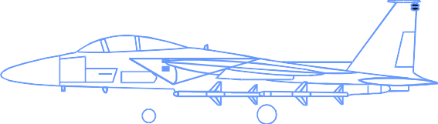
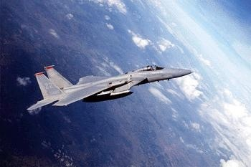



What is a model?
A model is a simplification of reality.

Slide 5
Why model?
Modeling achieves four aims:
Helps you to visualize a system as you want it to be.
Permits you to specify the structure or behavior of a system.
Gives you a template that guides you in constructing a system.
Documents the decisions you have made.
You build models of complex systems because you cannot comprehend such a system in its entirety.
You build models to better understand the system you are developing.

Slide 6
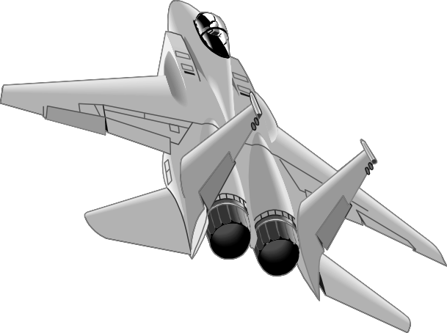

The importance of Modeling
Less important
More important
Paper Airplane
Fighter Jet

Slide 7
Software teams often do not model
Many software teams build applications approaching the problem like they were building paper airplanes
Start coding from project requirements
Work longer hours and create more code
Lacks any planned architecture
Doomed to failure
Modeling is a common thread to successful projects

Slide 8
Where are we?
What is modeling?
Four principles of visual modeling
The UML
Process and visual modeling

Slide 9
Four principles of modeling
The model you create influences how the problem is attacked.
Every model may be expressed at different levels of precision.
The best models are connected to reality.
No single model is sufficient.

Slide 10
Principle 1: The choice of model is
important
The models you create profoundly influence how a problem is attacked and how a solution is shaped.
In software, the models you choose greatly affect your world view.
Each world view leads to a different kind of system.
Process Model
Deployment Model
Design Model

Slide 11
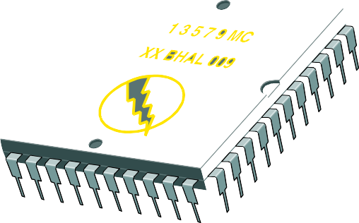




Principle 2: Levels of precision may
differ
Every model may be expressed at different levels of precision.
The best kinds of models let you choose your degree of detail, depending on:
Who is viewing the model.
Why they need to view it.
View for customers
View for designer

Slide 12
Principle 3: The Best Models Are
Connected to Reality
All models simplify reality.
A good model reflects potentially fatal characteristics.

Slide 13
Principle 4: No single model is sufficient
No single model is sufficient. Every non- trivial system is best approached through a small set of nearly independent models.
– Create models that can be built and studied separately, but are still interrelated.

Slide 14
Where are we?
What is modeling?
Four principles of visual modeling
The UML
Process and visual modeling

Slide 15
What is the UML?
The UML is a language for
Visualizing
Specifying
Constructing
Documenting
the artifacts of a software-intensive system.

Slide 16
The UML Is a Language for
Visualizing
Communicating conceptual models to others is prone to error unless everyone involved speaks the same language.
There are things about a software system you can’t understand unless you build models.
An explicit model facilitates communication.

Slide 17
The UML Is a Language for
Specifying
The UML builds models that are precise, unambiguous, and complete.

Slide 18
The UML Is a Language for
Constructing
UML models can be directly connected to a variety of programming languages.
Maps to Java, C++, Visual Basic, and so on
Tables in a RDBMS or persistent store in an OODBMS
Permits forward engineering
Permits reverse engineering

Slide 19
The UML Is a Language for Documenting
The UML addresses documentation of system architecture, requirements, tests, project planning, and release management.
Use Case Diagram
Deployment Diagram
ºÐ»ê È¯°æÀÇ ÇÏµå¿þ¾î¹× ³×Æ®¿÷À¸·ÎÀÇ Á¤º¸ ½Ã½ºÅÛ ¿¬°á ¸ðµ¨
À©µµ¿ì 95 : Å¬¶óÀÌ¾ðÆ®
À©µµ¿ì NT: ÀÀ¿ë¼¹ö
- À¯´Ð½º ¸Ó½Å: ÀÀ¿ë ¼¹ö ¹× µ¥ÀÌÅ¸ ¼¹ö, Åë½Å ¼¹ö
- IBM ¸ÞÀÎÇÁ·¹ÀÓ: µ¥ÀÌÅ¸ ¼¹ö, Åë½Å ¼¹ö
Use Case 1
Window95
Windows95
Windows95
Actor A
Use Case 2
Actor B
¹®¼°ü¸®
Å¬¶óÀÌ¾ðÆ®.EXE
Windows NT
¹®¼°ü¸® ¾ÖÇÃ¸´
¹®¼°ü¸® ¿£Áø.EXE
Solaris
UANlpIhXa
Use Case 3
Windows NT
IBM
Mainframe
µ¥ÀÌÅ¸º£ÀÌ½º¼¹ö
ÀÀ¿ë¼¹ö.EXE
user
mainWnd
fileMgr : FileMgr
document : Document
gFile
repository
FileMgr
DocumentList
Document
Æ¯Á¤¹®¼¿¡ ´ëÇÑ º¸±â¸¦
»ç¿ëÀÚ°¡ ¿äÃ»ÇÑ´Ù.
1: Doc view request ( )
fetchDoc( ) sortByName( )
add( ) delete( )
name : int
docid : int
numField : int
2: fetchDoc( )
3: create ( )
FileList
fList
get( )
open( )
close( ) read( )
sortFileList( )
create( ) fillDocument( )
code..
read() fill the
4: create ( )
5: readDoc ( )
add( ) delete( )
11
ÈÀÏ°ü¸®ÀÚ´Â ÀÐ¾î¿Â ¹®¼ÀÇ Á¤º¸¸¦ ÇØ´ç ¹®¼
°´Ã¼¿¡ ¼³Á¤À» ¿äÃ»ÇÑ´Ù.
6: fillDocument ( )
8: fillFile ( )
7: readFile ( )
Repository
rep
File
È¸é °´Ã¼´Â ÀÐ¾îµéÀÎ
°´Ã¼µé¿¡ ´ëÇØ ÀÌ¸§º°·Î Á¤·ÄÀ» ½ÃÄÑ È¸é¿¡
º¸¿©ÁØ´Ù.
9: sortByName ( )
(from Persistence)
read( )
GrpFile
readDoc( ) readFile( )
name : char * = 0
read( )
open( )
create( ) fillFile( )
Sequence Diagram
Class Diagram

Slide 20
History of the UML
UML 2.0
(2004)
UML 1.5
(March, ‘03)
UML
Partners’ Expertise
UML 1.1
(Sept. ‘97)
UML 1.0
(Jan. ‘97)
UML 0.9 and UML 0.91
(June ‘96) (Oct. ‘96)
Public Feedback
Unified Method 0.8
(OOPSLA ’95)
Booch ’93 OMT - 2
OOSE
Other Methods
Booch ‘91
OMT - 1

Slide 21
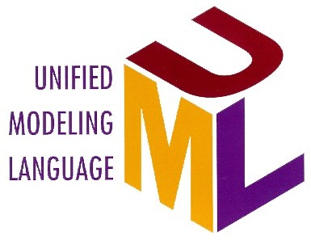
Inputs to the UML
Rumbaugh Booch
Meyer Before and after conditions
Jacobson
Fusion
Operation descriptions, message numbering
Harel
State charts
Embley
Singleton classes, High-level view
Gamma, et.al
Frameworks, patterns, notes
Shlaer- Mellor
Object lifecycles
Wirfs-Brock
Responsibilities
Selic, Gullekson, Ward
ROOM (Real-Time
Object-Oriented Modeling)
Odell
Classification

Slide 22
Where are we?
What is modeling?
Four principles of visual modeling
The UML
Process and visual modeling

Slide 23



A Language Is Not Enough to Build
a System
Team Based Development
Modeling Language
Unified Process

Slide 24
What Type of Process Most
Benefits the UML?
The UML is largely process independent. A process fully benefits from the UML when the process is:
Use-case driven
Architecture centric
Iterative and incremental

Slide 25

A Use-Case Driven Process
Use cases defined for a system are the basis for the entire development process.
Benefits of use cases:
Concise, simple, and understandable by a wide range of stakeholders.
Help synchronize the content of different models.
Check Balance
Withdraw Money

Slide 26
An Architecture-Centric Process
A system’s architecture is used as a primary artifact for conceptualizing, constructing, managing, and evolving the system under development.
Benefits:
Intellectual control over a project to manage its complexity and to maintain system integrity.
Effective basis for large-scale reuse.
A basis for project management.
Assistance in component-based development.

Slide 27
An Iterative and Incremental
Process
Critical risks are resolved before making large investments.
Initial iterations enable early user feedback.
Testing and integration are continuous.
Objective milestones focus on the short term.
Progress is measured by assessing implementations.
Partial implementations can be deployed

Slide 28
Iterative Development
Iteration 1 Iteration 2 Iteration 3
R
R
R
D
D
D
C
C
C
I
I
I
T
T
T
T I M E
Earliest iterations address greatest risks.
Each iteration produces an executable release, an additional increment of the system.
Each iteration includes integration and test.

Slide 29
Review
What is a model?
What are the four principles of modeling? Describe each one.
What is the UML? Describe each of its four benefits.
What process characteristics best fit the UML? Describe each characteristic.
What is an iteration?

